Slide 1
True / False
Inferential models are mainly used to understand how / why certain events occurred: True
“Average Bias” of a model refers to how much the model prediction differs from actual outcome on average across models estimated on different independent samples: True
“Variance” of a model refers to the variance of model predictions across models estimated on different independent samples: True

Slide 2
True / False
Improving a model’s fit on training data improves its predictive performance: False
Improving in-sample fit can lead to over-fitting the model to that specific training sample and worsen out-of-sample performance
Good predictive models are often biased: True
Because of the bias-variance tradeoff, it is possible to improve predictive accuracy by making the model biased
Stepwise iterative procedure for model selection, selects the best fitting model from all possible models: False
Stepwise only considers some of the possible models (at each step only one variable can be added / dropped, so drastically different models are not considered), and the selected model is sensitive to the starting point
Cross-validation can be used to select a model (or its tuning parameters) based on out-of-sample performance: True

Slide 3
True / False
If a model was selected using cross-validation, then the model’s cross-validation performance (e.g., ASE) underestimates its true out-of-sample performance: False
It overestimates true performance since model was selected to perform well for cross-validation
Parameters estimated using LASSO regression are biased: True
Bootstrapping creates simulated datasets by sampling form an initial dataset with replacement: True
Bagging combines the predictions from an ensemble of models estimated from samples simulated by bootstrapping: True

Slide 4
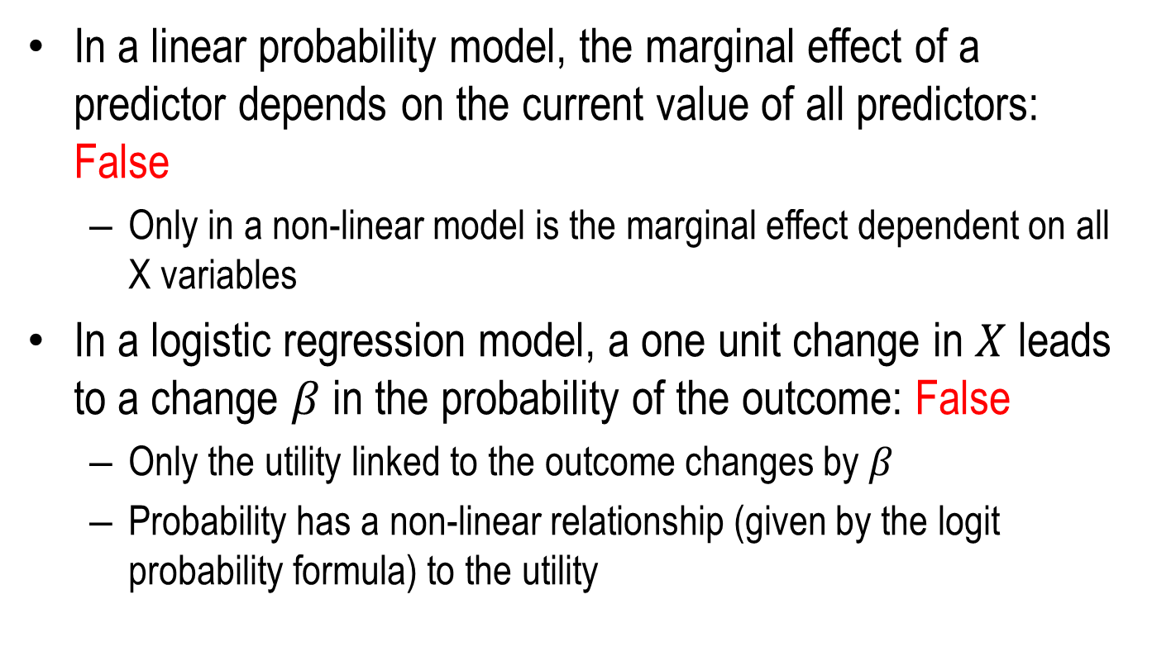
True / False
In a linear probability model, the marginal effect of a predictor depends on the current value of all predictors: False
Only in a non-linear model is the marginal effect dependent on all X variables
In a logistic regression model, a one unit change in $X$ leads to a change $β$ in the probability of the outcome: False
Only the utility linked to the outcome changes by $β$
Probability has a non-linear relationship (given by the logit probability formula) to the utility

